Slide 1











1
DIGITAL TWIN: ENABLING TECHNOLOGIES, CHALLENGES AND OPEN RESEARCH
NAZIFA BUSHRA
ID: 20101536
COURSE: CSE438
SECTION: 1

Slide 2
2
INTRODUCTION
Embarking on a journey through the transformative landscape of Industry 4.0, our presentation unveils the revolutionary role of Digital Twins, seamlessly integrating advanced data analytics and IoT connectivity. As we explore the synergy between IoT and data analytics, we witness the dynamic impact on manufacturing, healthcare, and smart city environments, unlocking vast data reservoirs. Digital Twins, at the heart of this revolution, emerge as a solution for real-time decision-making by creating connected physical and virtual twins. Our research focus revolves around four key questions, delving into the definitions, applications, challenges, and enabling technologies within manufacturing, healthcare, and smart cities. Our exploration is grounded in a targeted review of relevant publications since 2015, employing a meticulous methodology guided by specific keywords. We unravel the essence of Digital Twins, debunking common misconceptions, and navigate through challenges in their implementation. Technological pillars supporting Digital Twins are unveiled, accompanied by a brief historical backdrop for each enabling technology. Insights are categorized through shared challenges and enabling technologies, offering a comprehensive view in a tabulated format. A detailed analysis of current research, industry perspectives, and a forward-looking exploration of open research areas and challenges culminate in a reflective summary of key findings. The presentation concludes with an invitation for questions, fostering engagement and discussion among curious minds.

Slide 3
3
DIGITAL TWIN
The presentation embarks on an exploration of Digital Twins, commencing with an examination of its origins and foundational concepts. Subsequently, the evolving definitions of Digital Twins are scrutinized, tracing the terminology back to the early 2000s and discerning variations that have surfaced over time. An essential facet of this discourse involves dispelling misconceptions, particularly in distinguishing Digital Models, Shadows, and authentic Digital Twins. Transitioning to practical applications, the presentation navigates the diverse utility of Digital Twins in smart cities, manufacturing, and healthcare. Smart cities leverage Digital Twins for urban planning, energy optimization, and real-time monitoring, while manufacturing gains real-time insights, predictive analytics, and alignment with the Industry 4.0 paradigm. Healthcare benefits from the transformative role of Digital Twins in real-time analysis, drug effect simulations, and potential life-saving decisions. Further emphasis is placed on Digital Twin platforms adopted by industry leaders such as GE, Siemens, and PTC, showcasing the convergence of Industrial Internet of Things (IIoT), data analytics, and Digital Twins in shaping industrial landscapes. Open-source initiatives, including Eclipse's "Ditto" and Bentley Systems' "imodel.js," democratize Digital Twin development, contributing to a more accessible landscape. Moreover, industry perspectives are examined, contrasting the strategies of major players in the adoption or retreat from Digital Twins. Looking ahead, the presentation considers potential advancements driven by the integration of Artificial Intelligence (AI), Internet of Things (IoT), and Industry 4.0. The discourse concludes by opening the floor for questions and discussions, inviting a deeper exploration of the transformative journey of Digital Twins.

Slide 4

4
CHALLENGES IN DIGITAL TWIN IMPLEMENTATION
DATA ANALYTIC CHALLENGES:
IT INFRASTRUCTURE, DATA QUALITY: COSTLY INFRASTRUCTURE, DATA QUALITY ASSURANCE, AND PRIVACY CONCERNS POSE CHALLENGES.
PRIVACY AND SECURITY: EVOLVING REGULATIONS AND FEDERATED LEARNING ADDRESS PRIVACY AND SECURITY IN DATA ANALYTICS
IOT/IIOT CHALLENGES:
DATA MANAGEMENT: CONTROLLING VAST IOT DATA, UPDATING INFRASTRUCTURE, AND ENSURING REAL-TIME CONNECTIVITY ARE CHALLENGES.
DIGITAL TWIN CHALLENGES:
IT INFRASTRUCTURE: EFFECTIVE DIGITAL TWINS RELY ON CONNECTED AND WELL-DESIGNED IT INFRASTRUCTURE.
USEFUL DATA: QUALITY, CONSISTENT DATA IS ESSENTIAL FOR OPTIMAL DIGITAL TWIN PERFORMANCE.
PRIVACY AND SECURITY: ENSURING SECURITY ALIGNS WITH REGULATIONS AND ADDRESSES SENSITIVE DATA CONCERNS.
TRUST: ESTABLISHING TRUST INVOLVES USER EDUCATION AND MODEL VALIDATION.
EXPECTATIONS: MANAGING USER EXPECTATIONS AND COMBATTING TRENDS-DRIVEN ADOPTION IS CHALLENGING.
STANDARDIZED AND DOMAIN MODELLING: LACK OF STANDARDIZED MODELLING AND DOMAIN CONSIDERATIONS HINDER DIGITAL TWIN DEVELOPMENT.

Slide 5
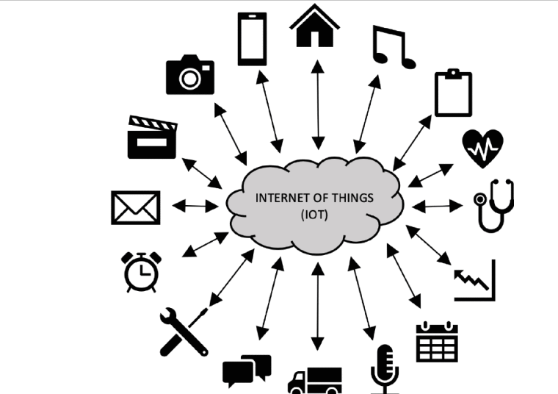
5
ENABLING TECHNOLOGIES FOR DIGITAL TWINS
History of IoT and IIoT:
IoT coined by Kevin Ashton in the '90s.
17 billion devices in 2018, projected 75 billion by 2025.
IIoT enhances industrial processes, market size to reach $110 billion by 2021.
I/IoT Enabling Technologies:
Four domains (D1-D4): Application, Middleware, Network, Object.
Covers application, middleware, network, and object layers.
Involves cloud platforms, data processing, communication protocols, and hardware platforms.
History of Data Analytics:
Umbrella term in "Data Science" covering statistics, AI, ML, and data visualization.
Enabling Technologies for Data Analytics:
Four domains (D5-D8): Object, Middleware, Network, Application.
Includes data collection, data processing, connectivity protocols, and hardware/visualization.
Enabling Technologies for Digital Twin:
Synthesis of functional domains (D9-D12): Application, Middleware, Network, Object.
Covers model architecture, storage technology, communication, and hardware/sensor technology.

Slide 6

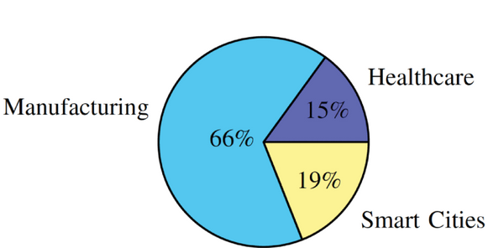
6
CURRENT RESEARCH IN DIGITAL TWINS
1. METHODOLOGY:
ADAPTED FROM KRITZINGER ET AL. [11].
LITERATURE SEARCH ON GOOGLE SCHOLAR (2015-2019).
FOCUS ON ACM, IEEE, AND SCIENCE DIRECT.
177 PAPERS REVIEWED (42 PRE-2017).
2. CATEGORICAL REVIEW TABLE:
ORGANIZED BY PAPER, TYPE, DEFINED TWIN, ACTUAL TWIN, BROAD AREA, SPECIFIC AREA, AND TECHNOLOGY.
THREE MAIN AREAS: HEALTHCARE, SMART CITIES, MANUFACTURING.
3. HEALTHCARE:
EXPANDING DIGITAL TWINS TO LIVING ENTITIES.
AI AND IOT FOR HEALTH IMPACT ASSESSMENT.
IOT AND INDUSTRY 4.0 FOR AUTONOMOUS SURGERY.
CLOUD-BASED DIGITAL TWIN FOR HEALTH MONITORING.
4. SMART CITIES:
MONITORING SPATIOTEMPORAL FLUX USING DIGITAL TWINS.
FRAMEWORKS FOR URBAN PLANNING AND ENERGY-EFFICIENT WIND FARMS.
DIGITAL TWINS FOR SMART FARMS AND TRAFFIC MANAGEMENT.
5. MANUFACTURING:
SMART MANUFACTURING REVIEWS EMPHASIZING BIG DATA.
SIMULATION AND AI FOR MANUFACTURING PROCESSES.
FAULT DIAGNOSIS USING DIGITAL TWINS AND AI.
SYSTEM DESIGN, DEVELOPMENT, AND BLOCKCHAIN INTEGRATION.
ENERGY-EFFICIENT MANUFACTURING THROUGH DIGITAL TWINS.
PERCENTAGE SHARE OF
RESEARCH AREAS IN THE ANALYSIS OF PAPERS.

Slide 7
7
Open Research Questions and Challenges in Digital Twins:
B. Digital Twin in Healthcare:
Modelling Human Bodies for Digital Twins.
Data Fusion Challenges in Healthcare.
Opportunities in Remote Surgery and Healthcare.
Ensuring Data Privacy and Security in Healthcare.
A. Digital Twin in Manufacturing:
Lack of Fully Integrated Digital Twins in Industry.
Need for Generic Models for Complete Digital Twins.
Data Fusion Challenges and the Promise of Predictive Maintenance.
Prognostics and Health Management (PHM) Opportunities.
Potential for Interaction and Collaboration of Machines.
C. Digital Twin in Smart Cities:
Standardization of Digital Twins for Smart Cities.
Data Fusion Challenges for Physical and Virtual Interchange.
Development of Generic Models for Smart Cities.
Integration of Digital Twins with Local Infrastructure.
D. Common Needs and Specific Findings:
Lack of Unified Models and Generic Architectures.
Handling Heterogeneous Systems in Digital Twin Environments.
Evaluating the Impact of AI on Digital Twins.
Security Challenges and Opportunities with Blockchain.
Ensuring Seamless Data Exchange for Small to Large Systems.
Retrofitting Sensors for Accurate IoT Data Exchange.
E. Challenges to Open Research:
Multidisciplinarity in Design and Development.
Lack of Standardization Hindering Progress.
Global Advancements Leading to Varying Growth Rates.
Connectivity and Data Exchange Challenges.
Security Risks with Accelerated Growth.

Slide 8

CONCLUSION
The rise of Digital Twins is propelled by a surge in research and industry investment, particularly in AI, IoT, and IIoT. Manufacturing stands out as the primary focus, showcasing a research gap in healthcare and smart city applications. The integration of AI into Digital Twins is an emerging area, with potential applications explored in limited publications. Challenges, such as the lack of standardization and unclear definitions, need addressing to ensure accurate developments in Digital Twins.
Within healthcare, the emphasis is on predictive analytics, with studies delving into monitoring health statuses and predicting outcomes. Remote surgery advancements and the critical need for research in secure data fusion, especially due to sensitive healthcare data, are highlighted. Research in smart cities is nascent but shows potential, particularly in traffic management systems and overall smart city development.
Despite being in its early stages and predominantly focused on manufacturing, the review serves as a foundational resource for future exploration. It provides insights into existing challenges and guides researchers in advancing the understanding and application of Digital Twins across diverse domains.

